Slide 1




Slide 2
Welcome!
It’s our first meetup, You’re all welcome !
This course is for AWS cloud administration
Finally will discuss about the AWS Interview Questions.

Slide 3



Slide 4

AWS Cloud

Slide 5
What to expect from this AWS Cloud
AWS Concepts: AWS Regions, Availability Zones & AWS Services
Understanding EC2 Instance options and how to choose the right one/mix for your workload
Understanding Storage options and how to choose the right one/mix of your workload
The basics of VPC networking and setting up a Load Balancer
Monitoring , Metrics & Logs
Security and Access Control
Deployment ( website hosting)
EC2 Cost Optimization

Slide 6
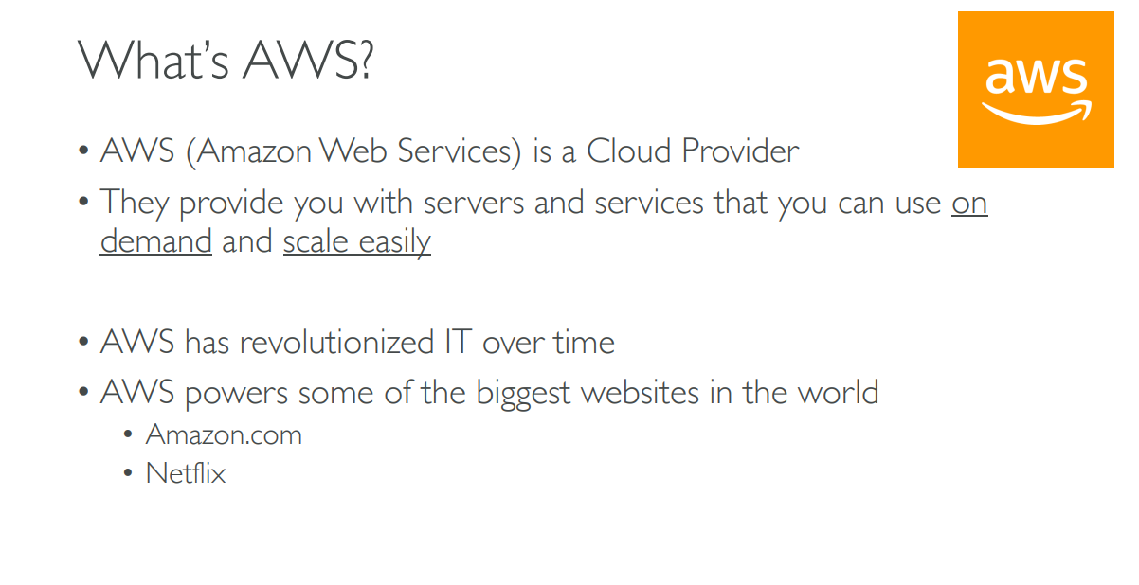
What is Amazon Web Services?

Slide 7
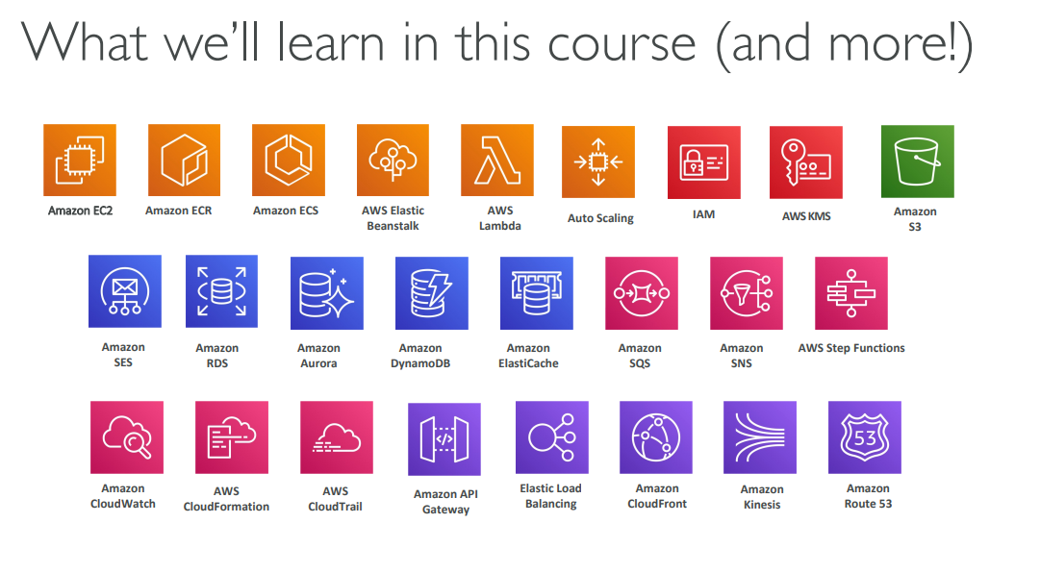

Slide 8
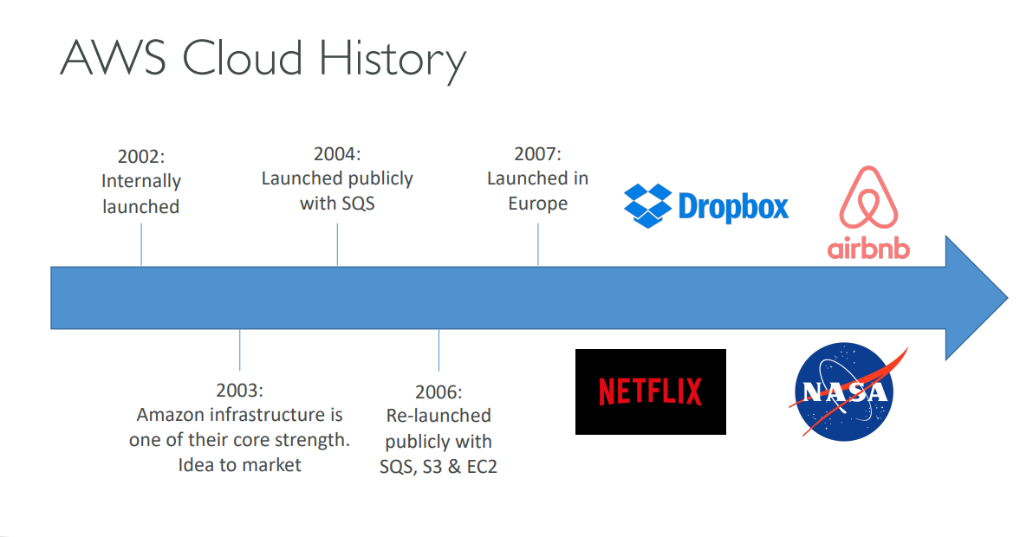

Slide 9
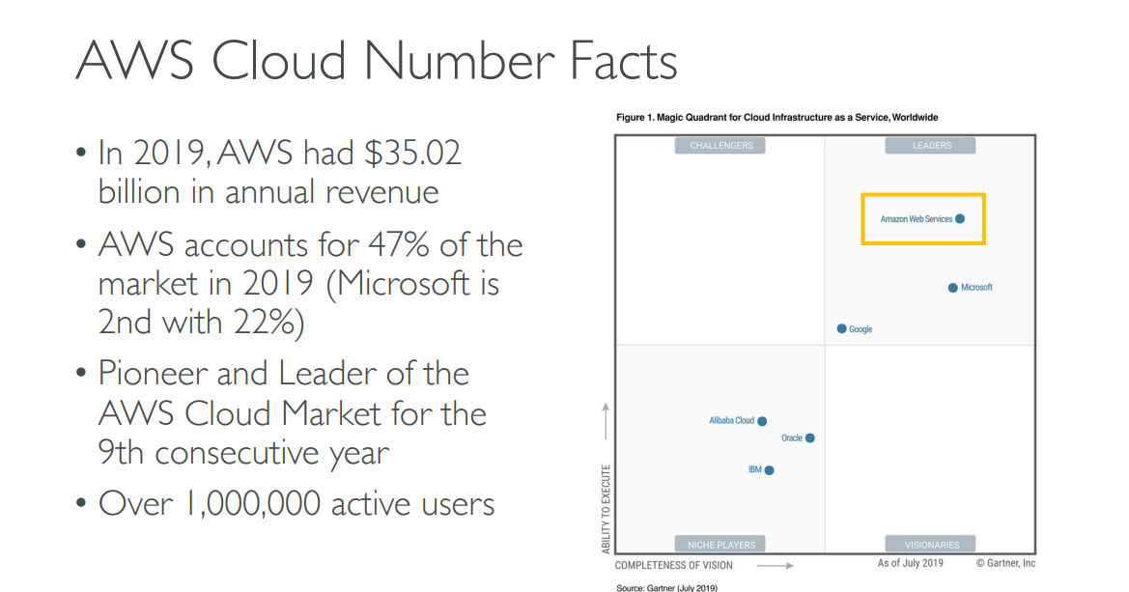

Slide 10
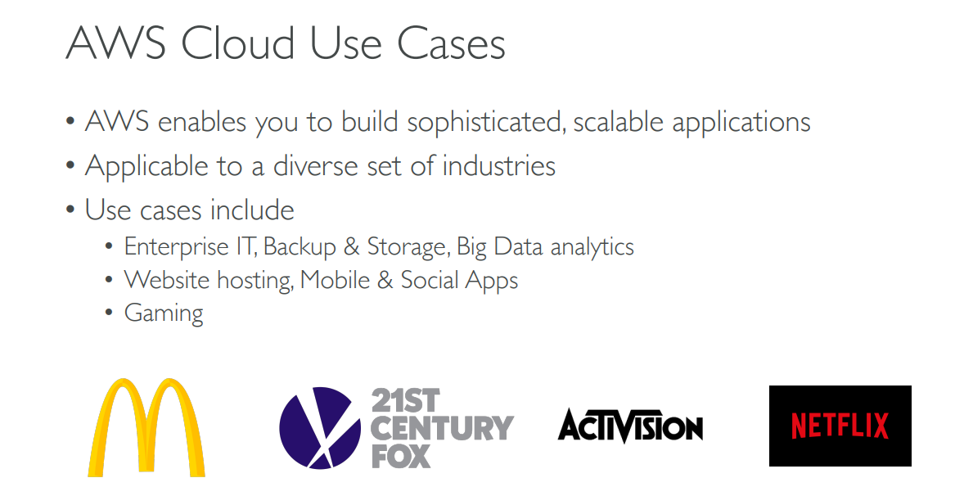

Slide 11
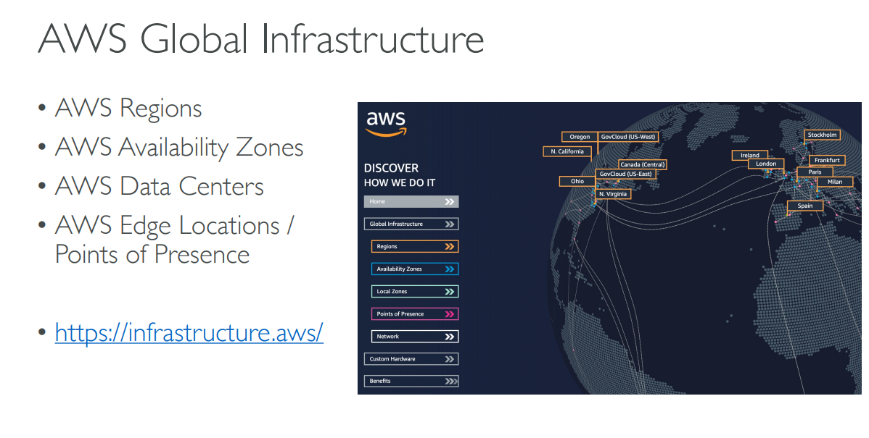

Slide 12
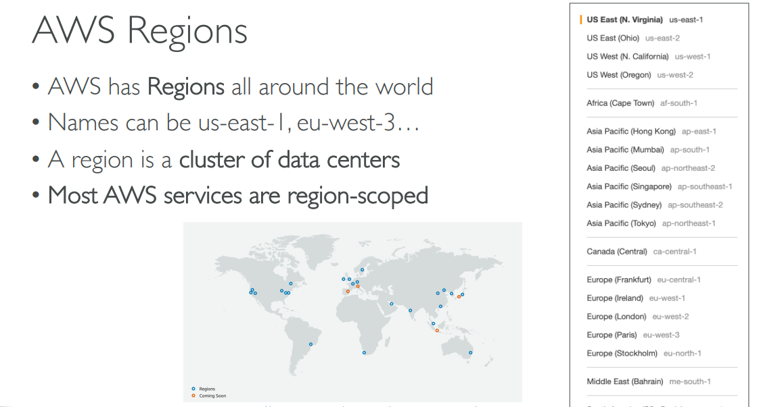

Slide 13
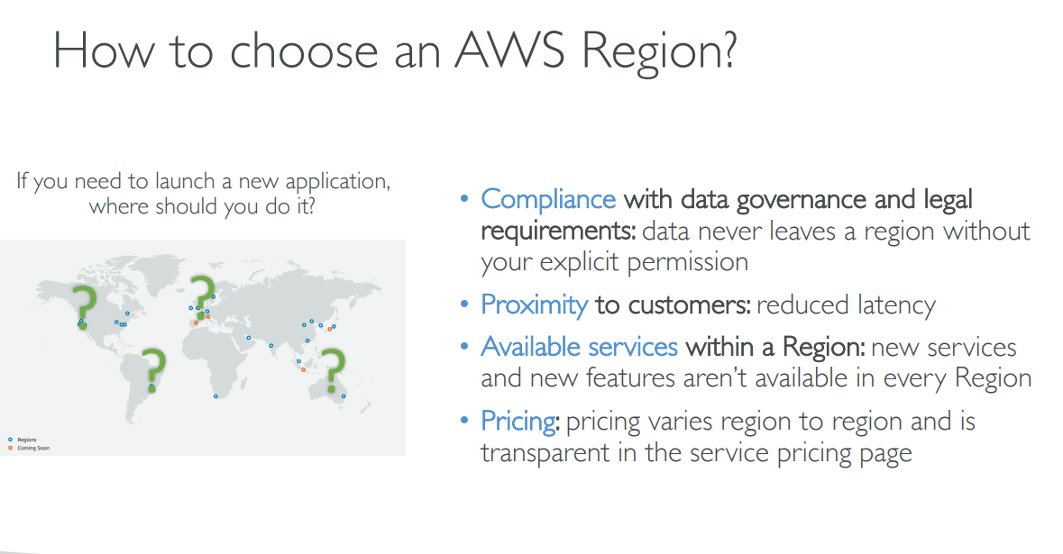

Slide 14
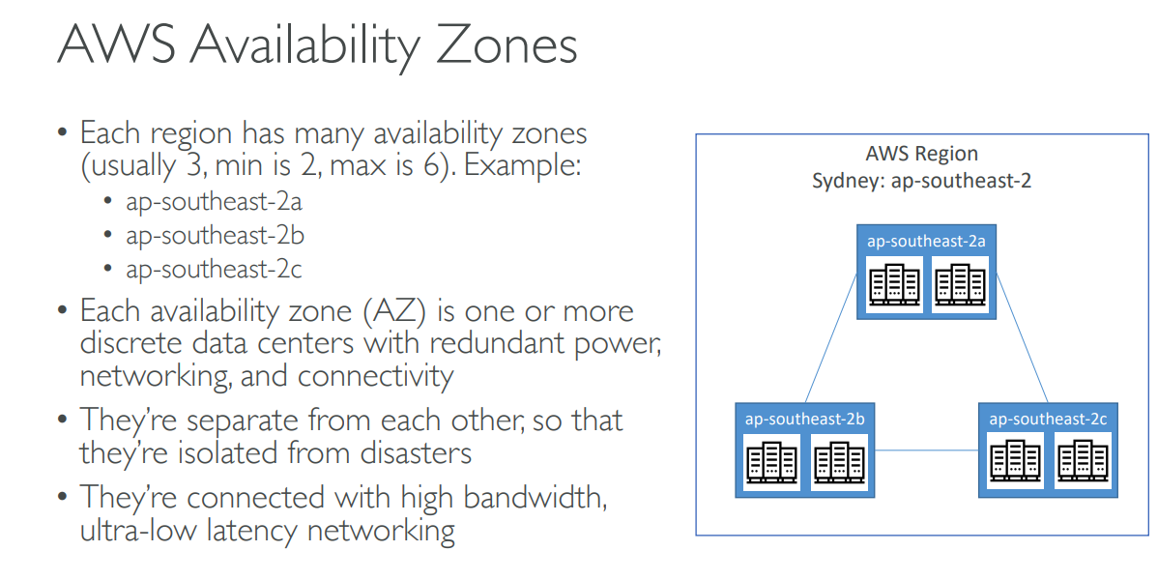




Slide 15
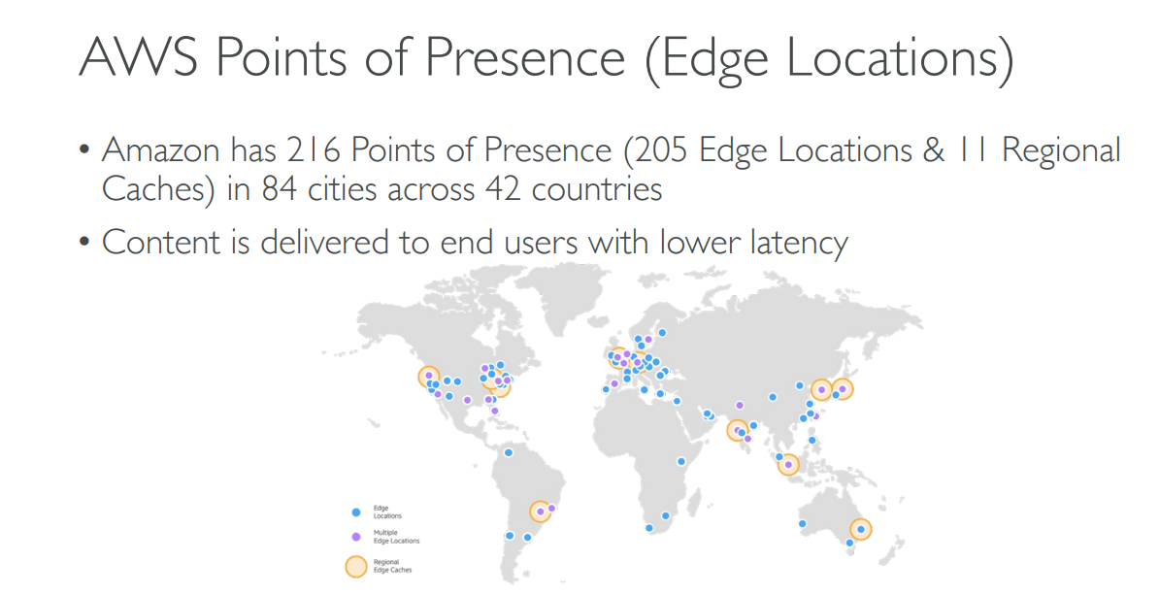

Slide 16
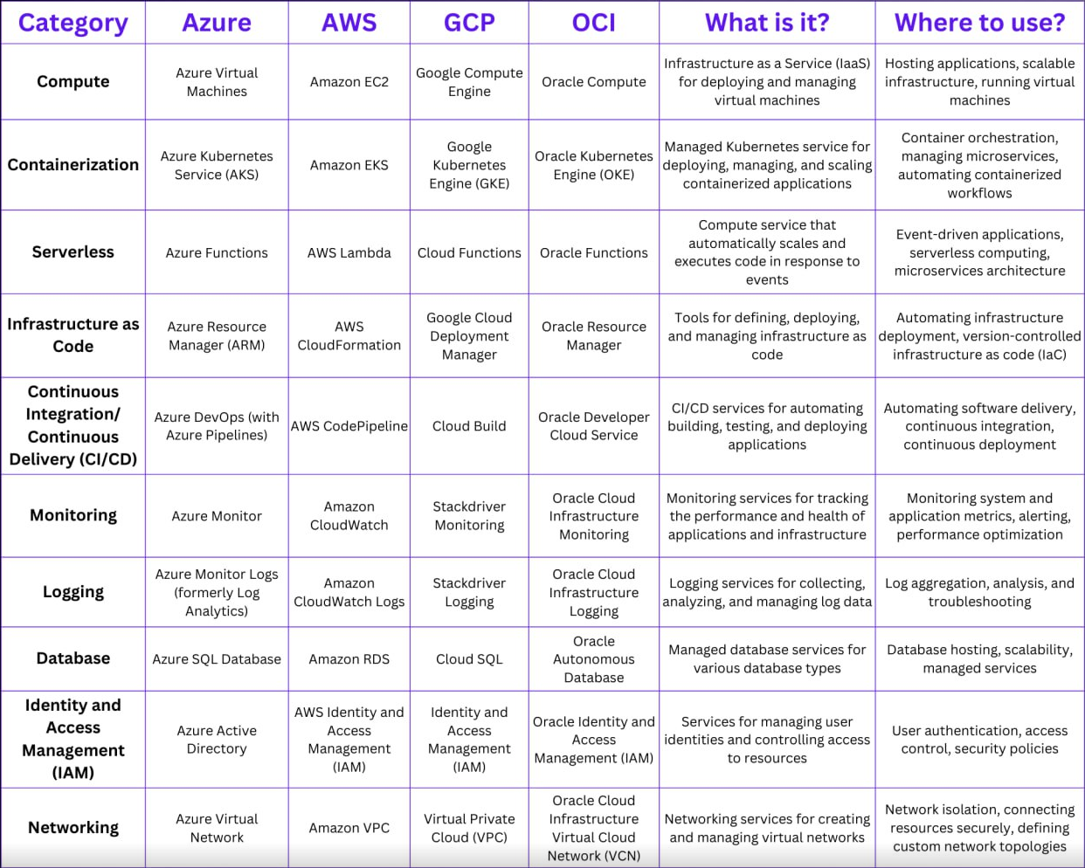

Slide 17

Questions & Answers
Open the floor for questions from participants

Slide 18

Email me at cheruku.harikrishna@gmail.com

